Slide 1

Neural Mechanisms of Abstract Visual Cognition
David J. Freedman
Department of Neurobiology
The University of Chicago
http://www.freedmanlab.org
Notes:
I’m looking forward to telling you about recent experimental and theoretical work in my lab aimed at understanding how visual feature encoding is transformed by the cortical hierarchy to support flexible complex behaviors.

Slide 2

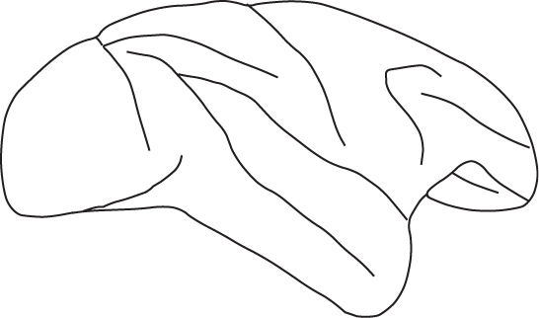
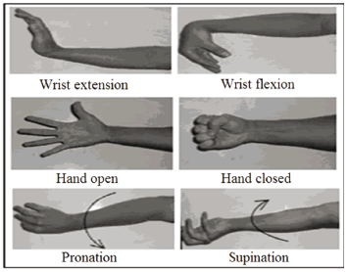


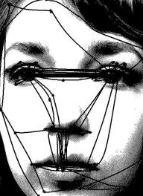

Notes:
Activity in early sensory areas (e.g. LGN or V1) shows a faithful or veridical encoding of stimulus features with little or no covariation with monkeys decisions. For example, if same stimulus leads to different decisions.
Activity in areas close to motor output tracks the animals’ movements, even when those movements are triggered by different sensory stimuli.
We are interested in understanding how visual features and read-out and transformed by downstream areas in order to recognize the meaning of incoming stimuli, and to enable flexible behavior.

Slide 3
PFC/FEF
MT
MST
LIP
SC
PFC

Slide 4
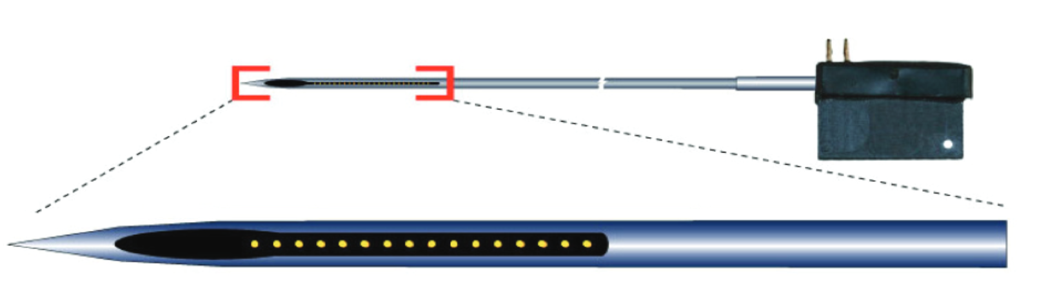
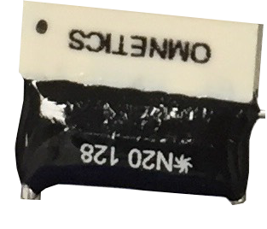
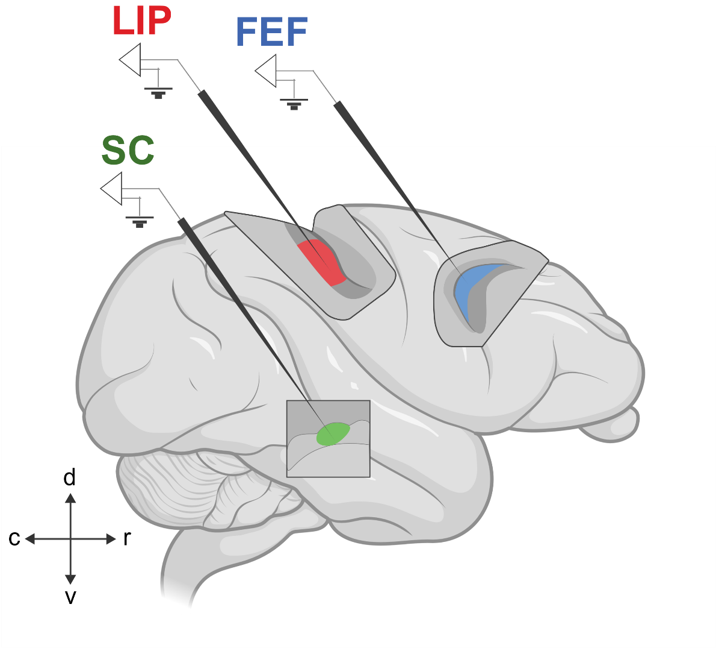
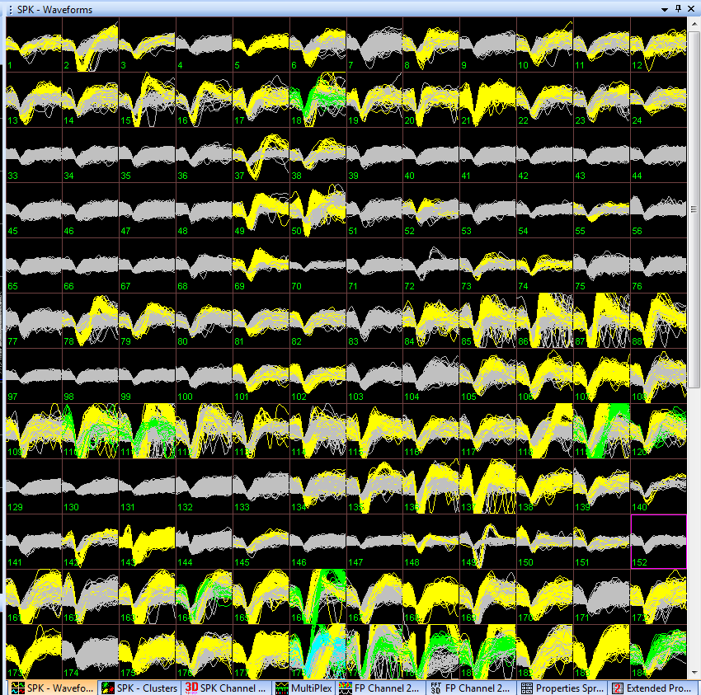
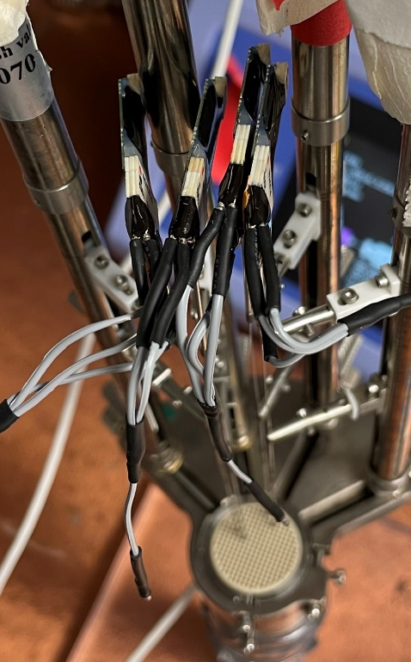


Simultaneous recordings capture encoding of categorical decisions across multiple primate brain areas at the single neuron and population levels.

Slide 5
Category 1
30°
Category 2
Category boundary
Notes:
We trained monkeys to categorize 360 deg of motion into two categories…
In the

Slide 6
Delayed Match to Category (DMC) Task
.
RELEASE
.
.
RF
.
(Match)
Fixation
500 ms.
Sample
.
650 ms.
Delay
HOLD
1000 ms.
Test
(Non-match)
DMC task requires:
Categorize sample
Short term memory
Compare test with remembered sample
650 ms.
Notes:
To understand how sensory signals are transformed into decision or action related signals, we need an approach that allows us to dissociate neuronal encoding related to sensory, decision, and motor factors.
Although originally motivated by the desire to understand mechanisms of visual categorization and category learning, our work provides an alternative perspective and framework for decision making, which provides greater flexibility and even computational efficiency.
The core approach is to dissociate the monkeys decisions about the stimulus from their planned motor responses allowing independent assessment of visual feature tuning, decision related activity, and motor related responses in our neuronal recordings.

Slide 7
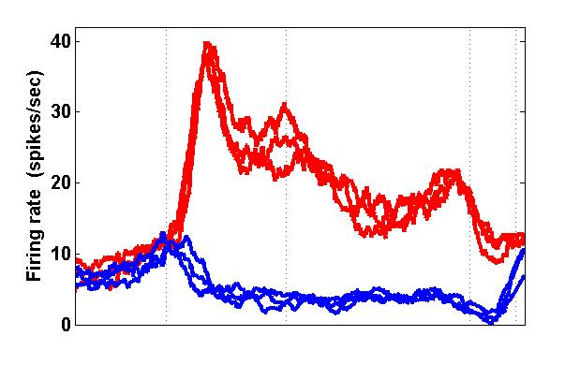
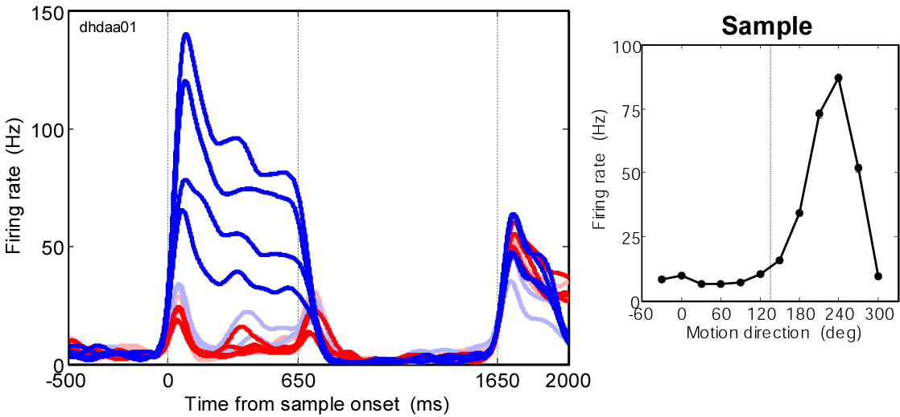
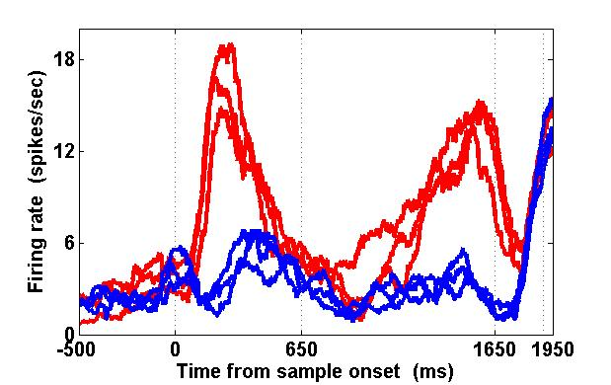
Neurons in LIP show abstract encoding of learned categories. MT shows veridical tuning for motion direction tuning, not category.
Delayed Match To Category Task
Sample
Delay
Test
Sample
Delay
Test
LIP
MT
Freedman and Assad (2006); Swaminathan and Freedman (2012)

Slide 8
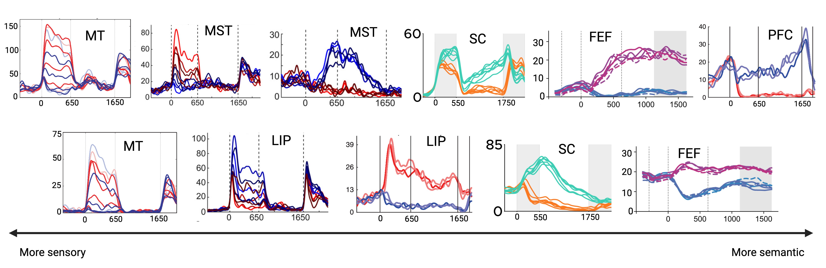
Activity across brain areas during motion category task spans a spectrum from direction to category encoding, and mixed category/direction tuning.
Freedman & Assad 2006 (LIP, MT) Zhou, Mohan, & Freedman 2022 (MST, LIP) Swaminathan & Freedman 2012 (LIP, PFC)
Peysakhovich et al 2023 (SC, LIP) Matt Rosen et al, unpublished (FEF)

Slide 9
As we have examined more spatial, attentional, and saccadic regions, we have found stronger abstract categorical encoding.

Slide 10


Superior Colliculus
Oliver Zhu
Vinay Shirhatti
Peysakhovich, Tetrick, Silva, Li, Zhu, Ibos, Johnston, and Freedman. bioRxiv 2023.01.17.524416. (2023)
Barbara Peysakhovich

Slide 11
Superior colliculus, an evolutionarily conserved structure found in all vertebrates
Traditionally viewed as mediating reflexive orienting movements of eyes and head
Recent work finds SC is engaged in cognitive tasks involving saccadic eye movements

Slide 12
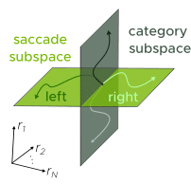
Reminder: DMC task does not involve saccades & we could not explain SC category encoding by microsaccades or other saccade metrics.
Hypothesis: Category encoding in SC is confined to the null subspace of saccade generation.
Peysakhovich, Tetrick, Silva, Li, Zhu, Ibos, Johnston, and Freedman. bioRxiv 2023.01.17.524416. (2023)

Slide 13
Suggests that core spatial processing brain networks are recruited to mediate abstract non-spatial cognition.

Slide 14







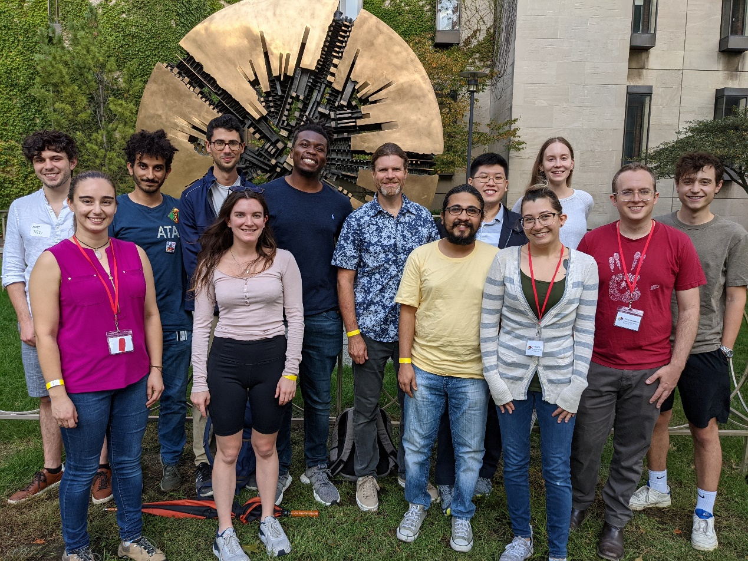





The Freedman Lab
www.freedmanlab.org
Ali Alamri
Suha Chang
Sam David
Jeff Johnston, Ph.D.
Chris Hauser, Ph.D.
Guilhem Ibos, Ph.D.
Kenneth Latimer, Ph.D.
Catherine Lee
Sihai Li, Ph.D.
Nicolas Masse, Ph.D.
Jillian McKee, Ph.D.
Pantea Moghimi, Ph.D.
Alex Medoff
Krithika Mohan, Ph.D.
Grace Nelson
Barbara Peysakhovich, Ph.D.
Chris Rishel, Ph.D.
Arup Sarma, Ph.D.
Sruthi Swaminathan, Ph.D.
Mathew Rosen
Vinay Shirhatti, Ph.D.
Stephanie Tetrick
Matthew Tilley, Ph.D.
Sam Zheng
Oliver Zhu
Yang Zhou, Ph.D.
Funding:

Slide 15
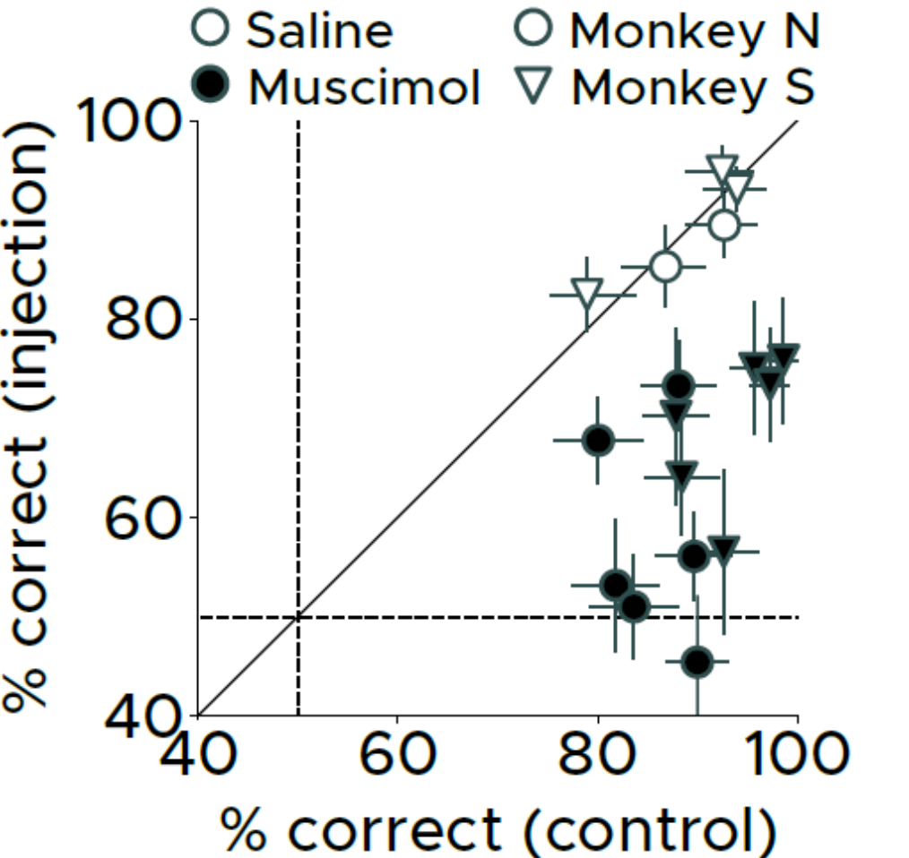
REVERSIBLE INACTIVATION OF SC DURING CATEGORIZATION TASK
Barbara Peysakhovich
SC inactivation dramatically impairs categorization task performance
Peysakhovich, Tetrick, Silva, Li, Zhu, Ibos, Johnston, and Freedman. bioRxiv 2023.01.17.524416. (2023)

Slide 16
Hypothesis: LIP is one of the critical stages for visual categorical decisions.
Notes:
Activity in early sensory areas (e.g. LGN or V1) shows a faithful or veridical encoding of stimulus features with little or no covariation with monkeys decisions. For example, if same stimulus leads to different decisions.
Activity in areas close to motor output tracks the animals’ movements, even when those movements are triggered by different sensory stimuli.
We are interested in understanding how visual features and read-out and transformed by downstream areas in order to recognize the meaning of incoming stimuli, and to enable flexible behavior.

Slide 17
COMPARING CATEGORY AND SACCADE INFLUENCES ON FIRING RATES
Nested linear encoding models quantified contributions to single-neuron sample-period activity of 1) stimulus category and 2) eye position
Category better accounted for SC activity than eye movements
Adding eye position as factor in model position did not significantly improve model fit over just category (in sample period)
Wouldn’t strong modulations of SC activity cause eye movements?

Slide 18
ARE CATEGORIES AND SACCADES ENCODED IN ORTHOGONAL NEURAL SUBSPACES?
PCA
PCA
Kaufman et al., (2014)

Slide 19
Category task SC activity better aligns with output-null axis from MGS task, potentially explaining how cognitive and saccade signals are jointly encoded by a motor structure like SC.
Notes:
Projecting DMC activity to output-potent and output-null axes of MGS task.

